Slide 1
VCAL - Applied Learning

Slide 2
Aim of this presentation?
To give you some information which will help you and your child decide if you should apply for VCAL
To start some conversations with you and your child about the shape and look of Applied Learning at Marian College

Slide 3
VCAL - Ready for work - Ready for life
Who is it for? Not everyone…….
Hands on Learners
Risk Takers
Busy people
Action orientated
Notes:
Often feel ‘different’ in a conventional class - due to structures of curriculum
Not talking about doing bad things, rather Like the challenge of doing something different
A great capacity for activity
Love to be doing and often for others

Slide 4
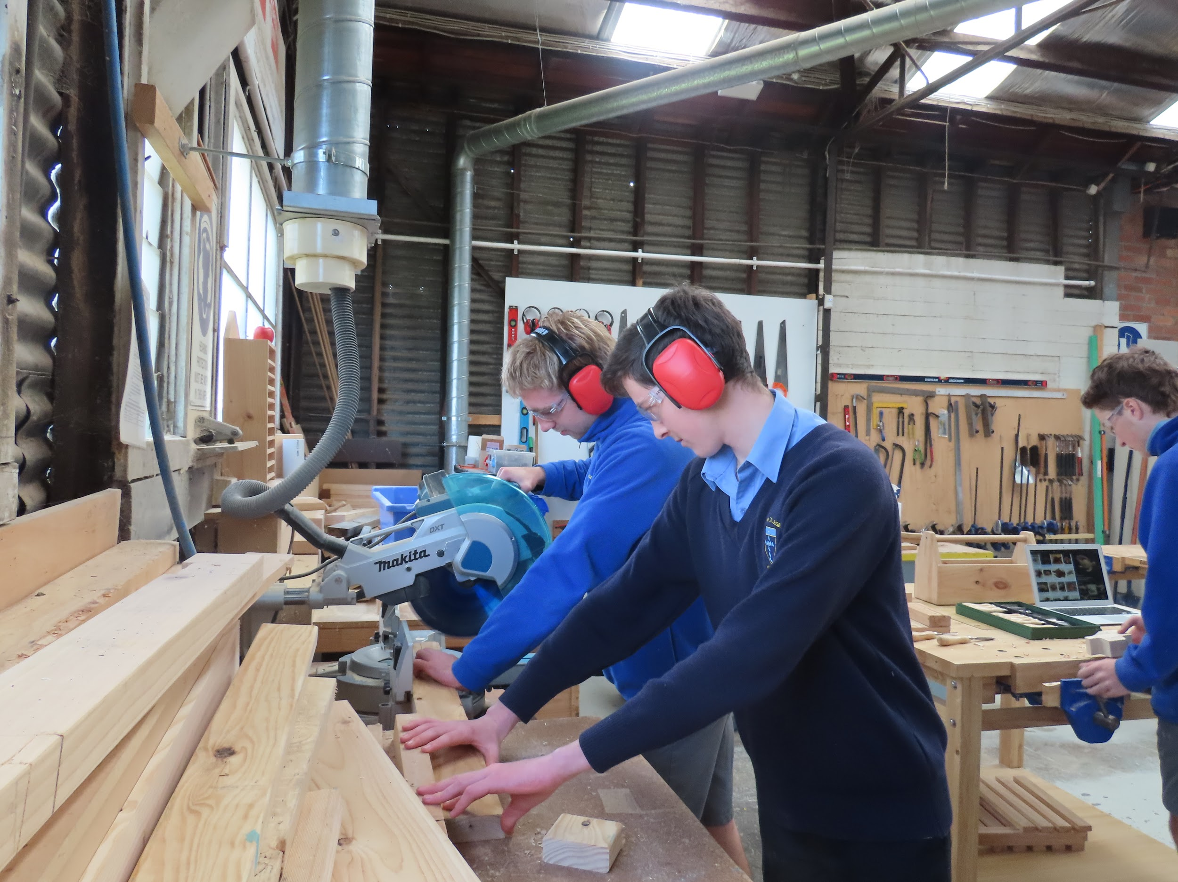
Pathways
Life after VCAL options
Apprenticeships
Traineeships
Full time industry specific employment
TAFE - Further studies
We have strong links with Westvic Employment and the CGLLEN
Notes:
University study may not apply - TAFE is more industry specific studies
To date - 6 Year 12 students have secured full time employment so far

Slide 5
VCAL - Three Levels
Foundation VCAL = We ASSIST you through every step of the way
Intermediate VCAL = We work WITH YOU to complete you tasks with some independence
Senior VCAL = You are given tasks and you can complete it INDEPENDENTLY
Certificates can be completed over 1 or 2 years, depending on what you get completed and in what manner you complete it in.

Slide 6
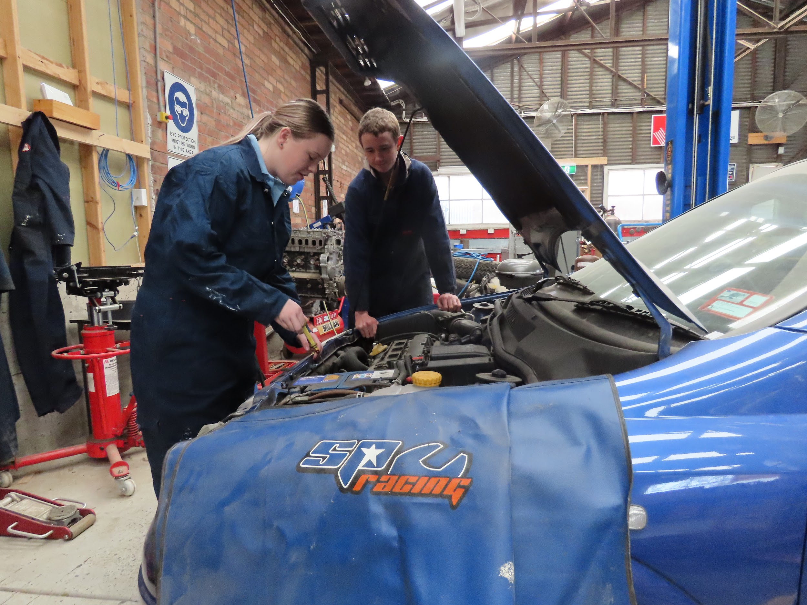
VCAL - Four study strands + 1 VET
Literacy
Numeracy
Personal Development
Work related skills
Industry specific VET subject

Slide 7
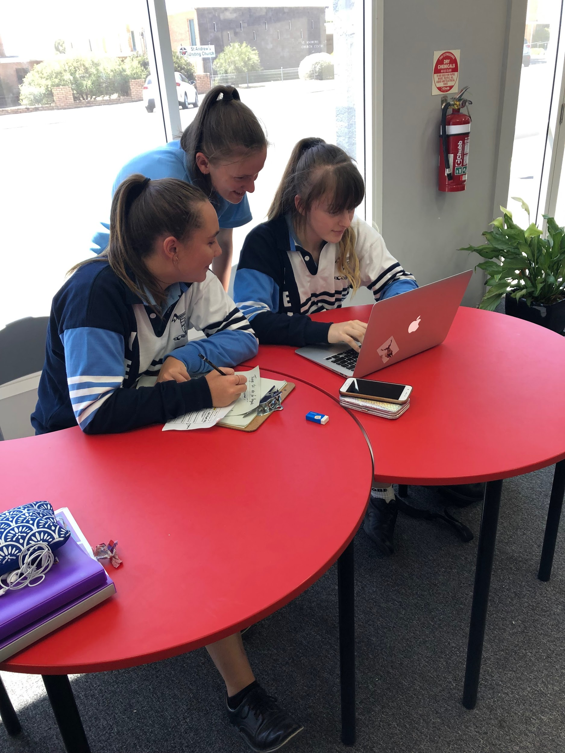
Literacy - Reading, Writing and Oracy
Practical purposes
Self-expression
Knowledge
Public Debate
Students have 12 Outcomes for Literacy they must reach and provide 3 forms of evidence for.
Notes:
Students have 8 Outcomes they must reach and provide 3 forms of evidence for.

Slide 8
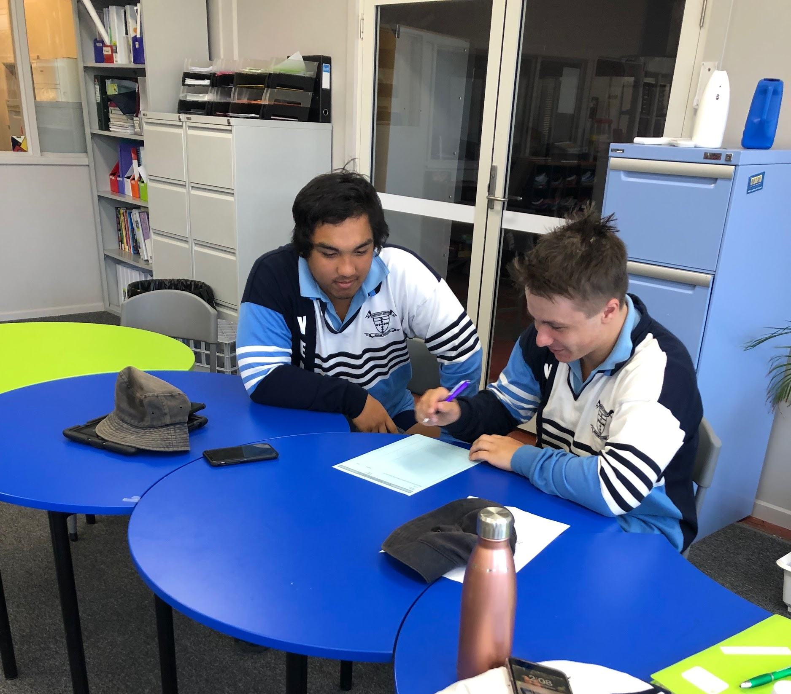
Numeracy
Numerical skills
Financial literacy
Planning & organising
Measurement, representation & Design
Students have 8 Outcomes for Numeracy they must reach and provide 3 forms of evidence for.

Slide 9
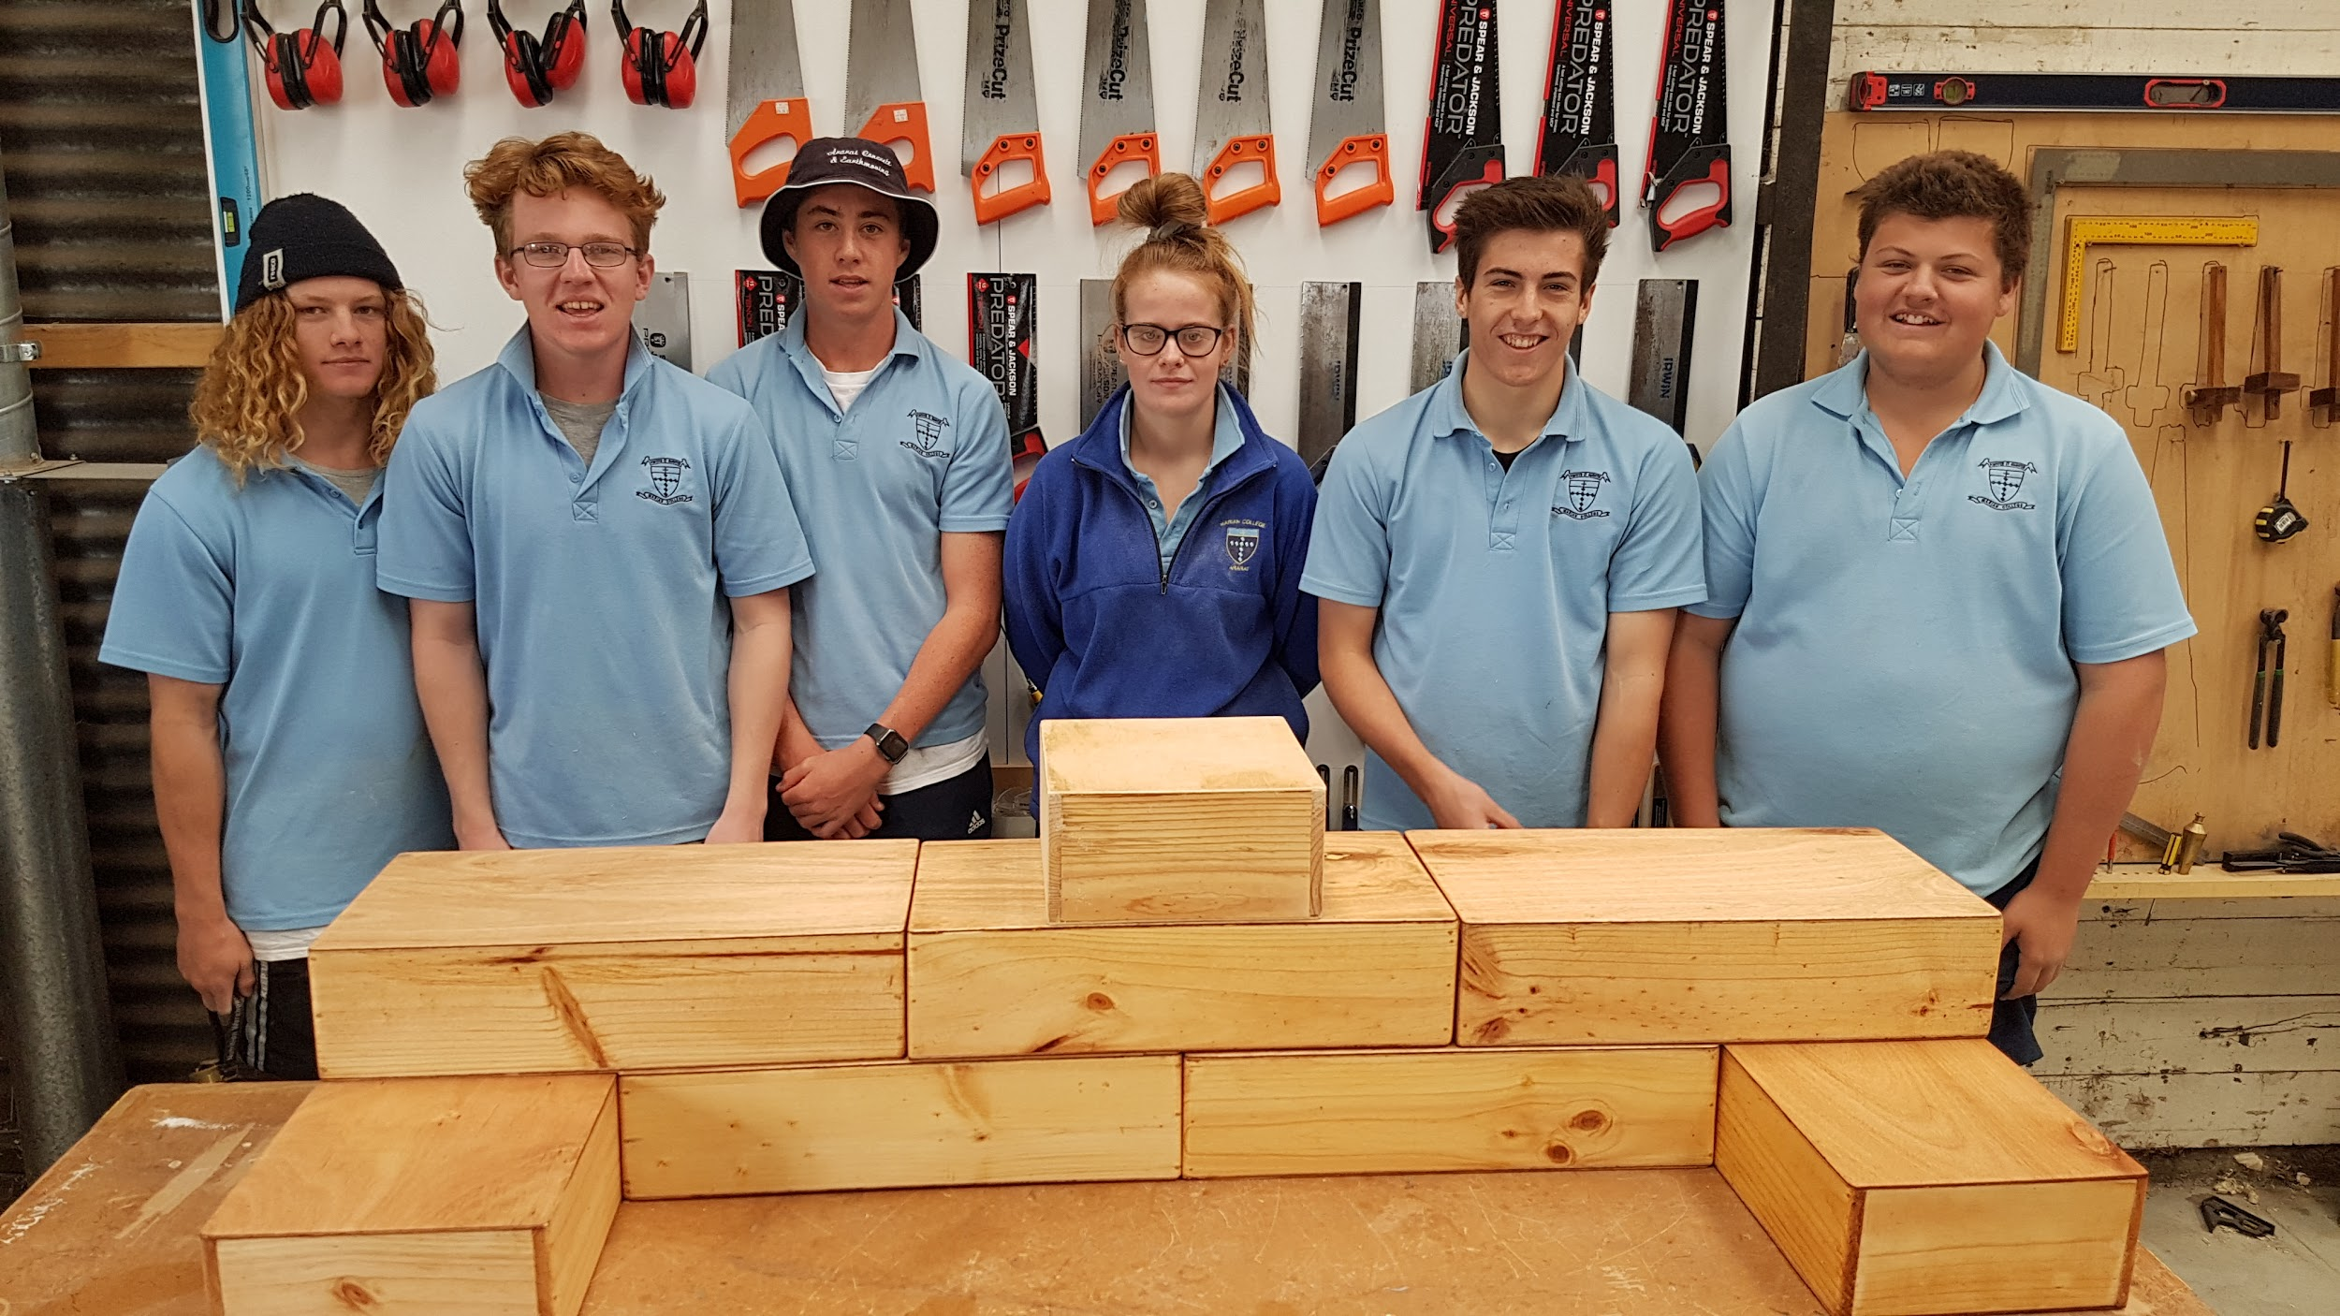
Personal Development Skills (PDS)
Plan and organise an activity/event
Self-management
Leadership
Interpersonal Skills
Students have 10 Outcomes for PDS they must reach and provide 3 forms of evidence for.

Slide 10
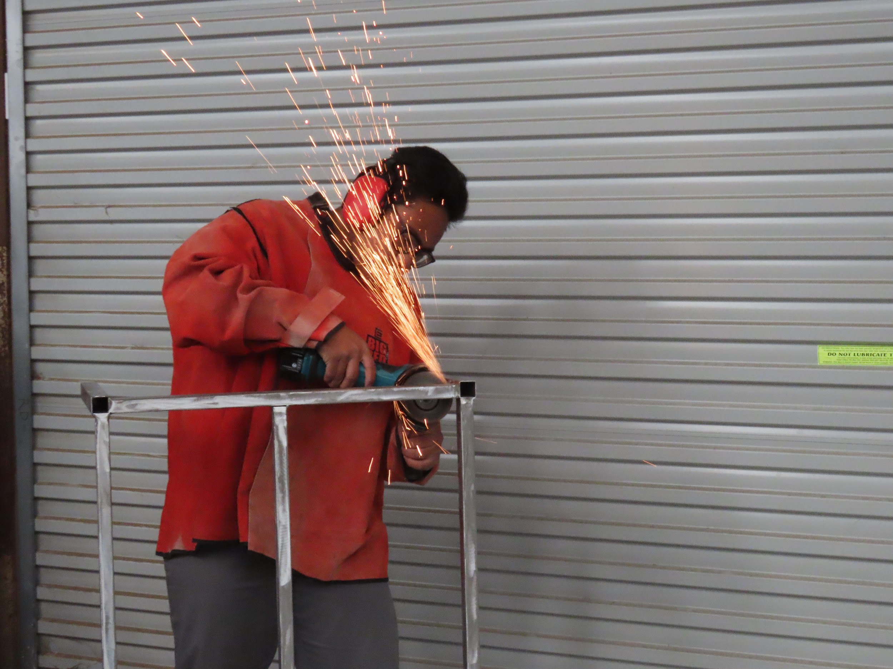
Work Related Skills (WRS)
Industry Knowledge
OHS
Risk Assessment
Technology
Design
Students have 12 Outcomes for WRS they must reach and provide 3 forms of evidence for.

Slide 11
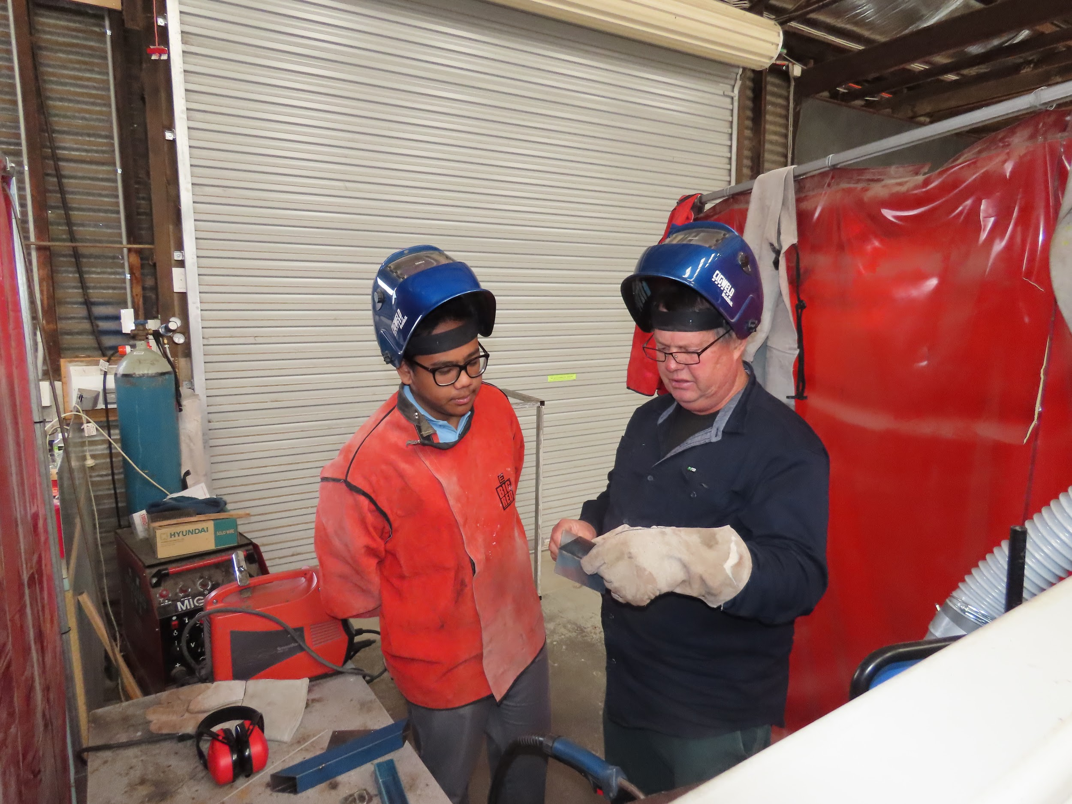
Work Placements
Students studying VCAL have the opportunity and flexibility to secure a Work placement.
There are 2 different types of work placements: Structured WorkPlace Learning and School Based Apprenticeships and Traineeships.

Slide 12
Structured Workplace Learning (SWL)
Structured Workplace Learning allows students to gain hands on skills related to the course they are studying at school.
Placements for Structured Workplace Learning can be undertaken in one week blocks or on a one day per week basis.
This cannot exceed 40 days in a year.
We strongly encourage all VCAL students to participate in SWL - as it provides experience and extra credits towards their certificate.

Slide 13
School Based Apprenticeships (SBAT)
School Based Apprenticeships and Traineeships are the same as normal apprenticeships and traineeships except that they are completed part time whilst you continue your schooling, rather than being done full time.
This year we have 4 students completing an SBAT, two in agriculture, one in Metal Fabrication and one as an electrician.
For further information - please contact our careers counsellor - Mrs Knights.

Slide 14
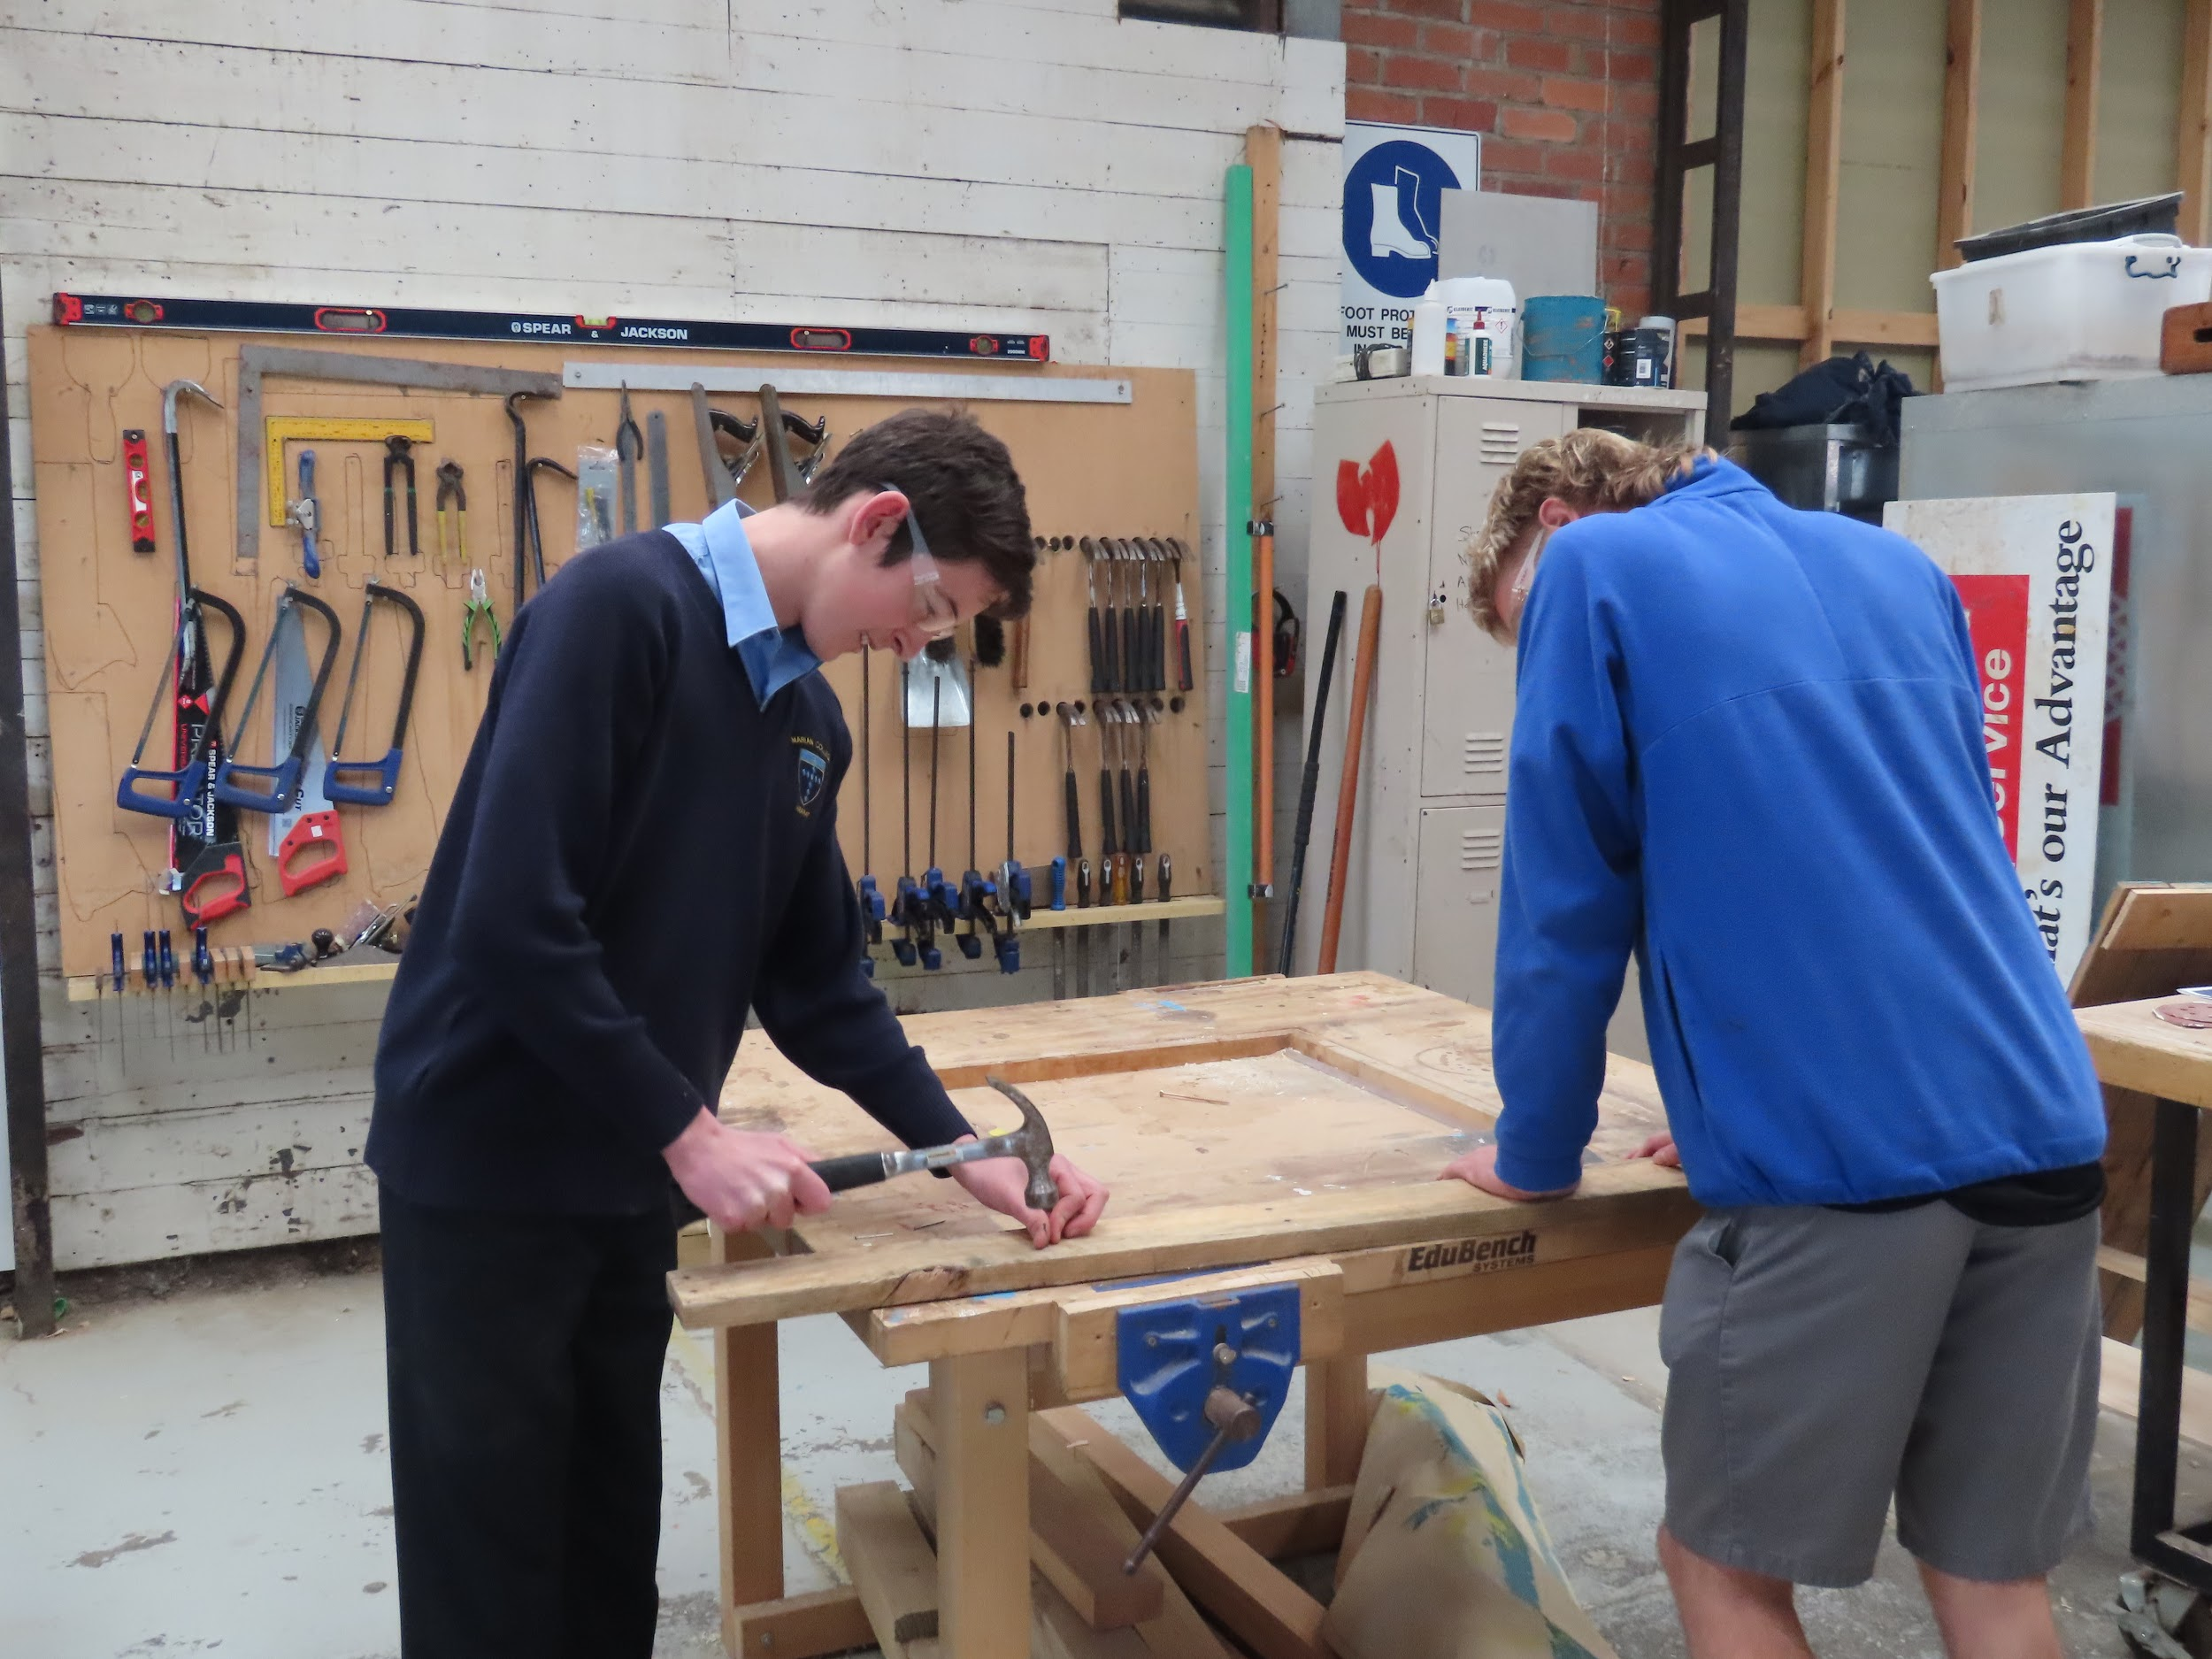
Alternative to VCE - Industry specific
Each strand has between 5 and 12 outcomes - each outcome has a minimum of 5 elements.
Each student is required to have a minimum of 3 pieces of evidence for each outcome.
Every outcome must be met as competent to be eligible.
Do your Maths!!!! It is constant, relentless and rigorous preparation for the work force.

Slide 15
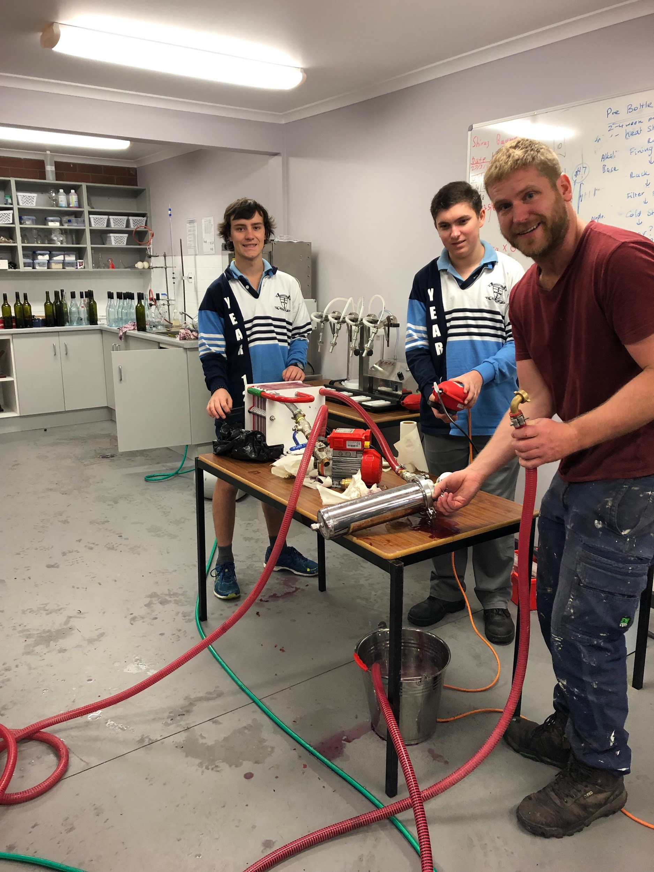
Alternative to VCE - Industry specific
VCE pathway is rigorous - study wise and with lots of information to remember.
VCAL - is more rigorous in time demands, constant work, deadlines and outcomes needed - not as memory related as VCE - but more skills related and absolutely no time to waste.

Slide 16
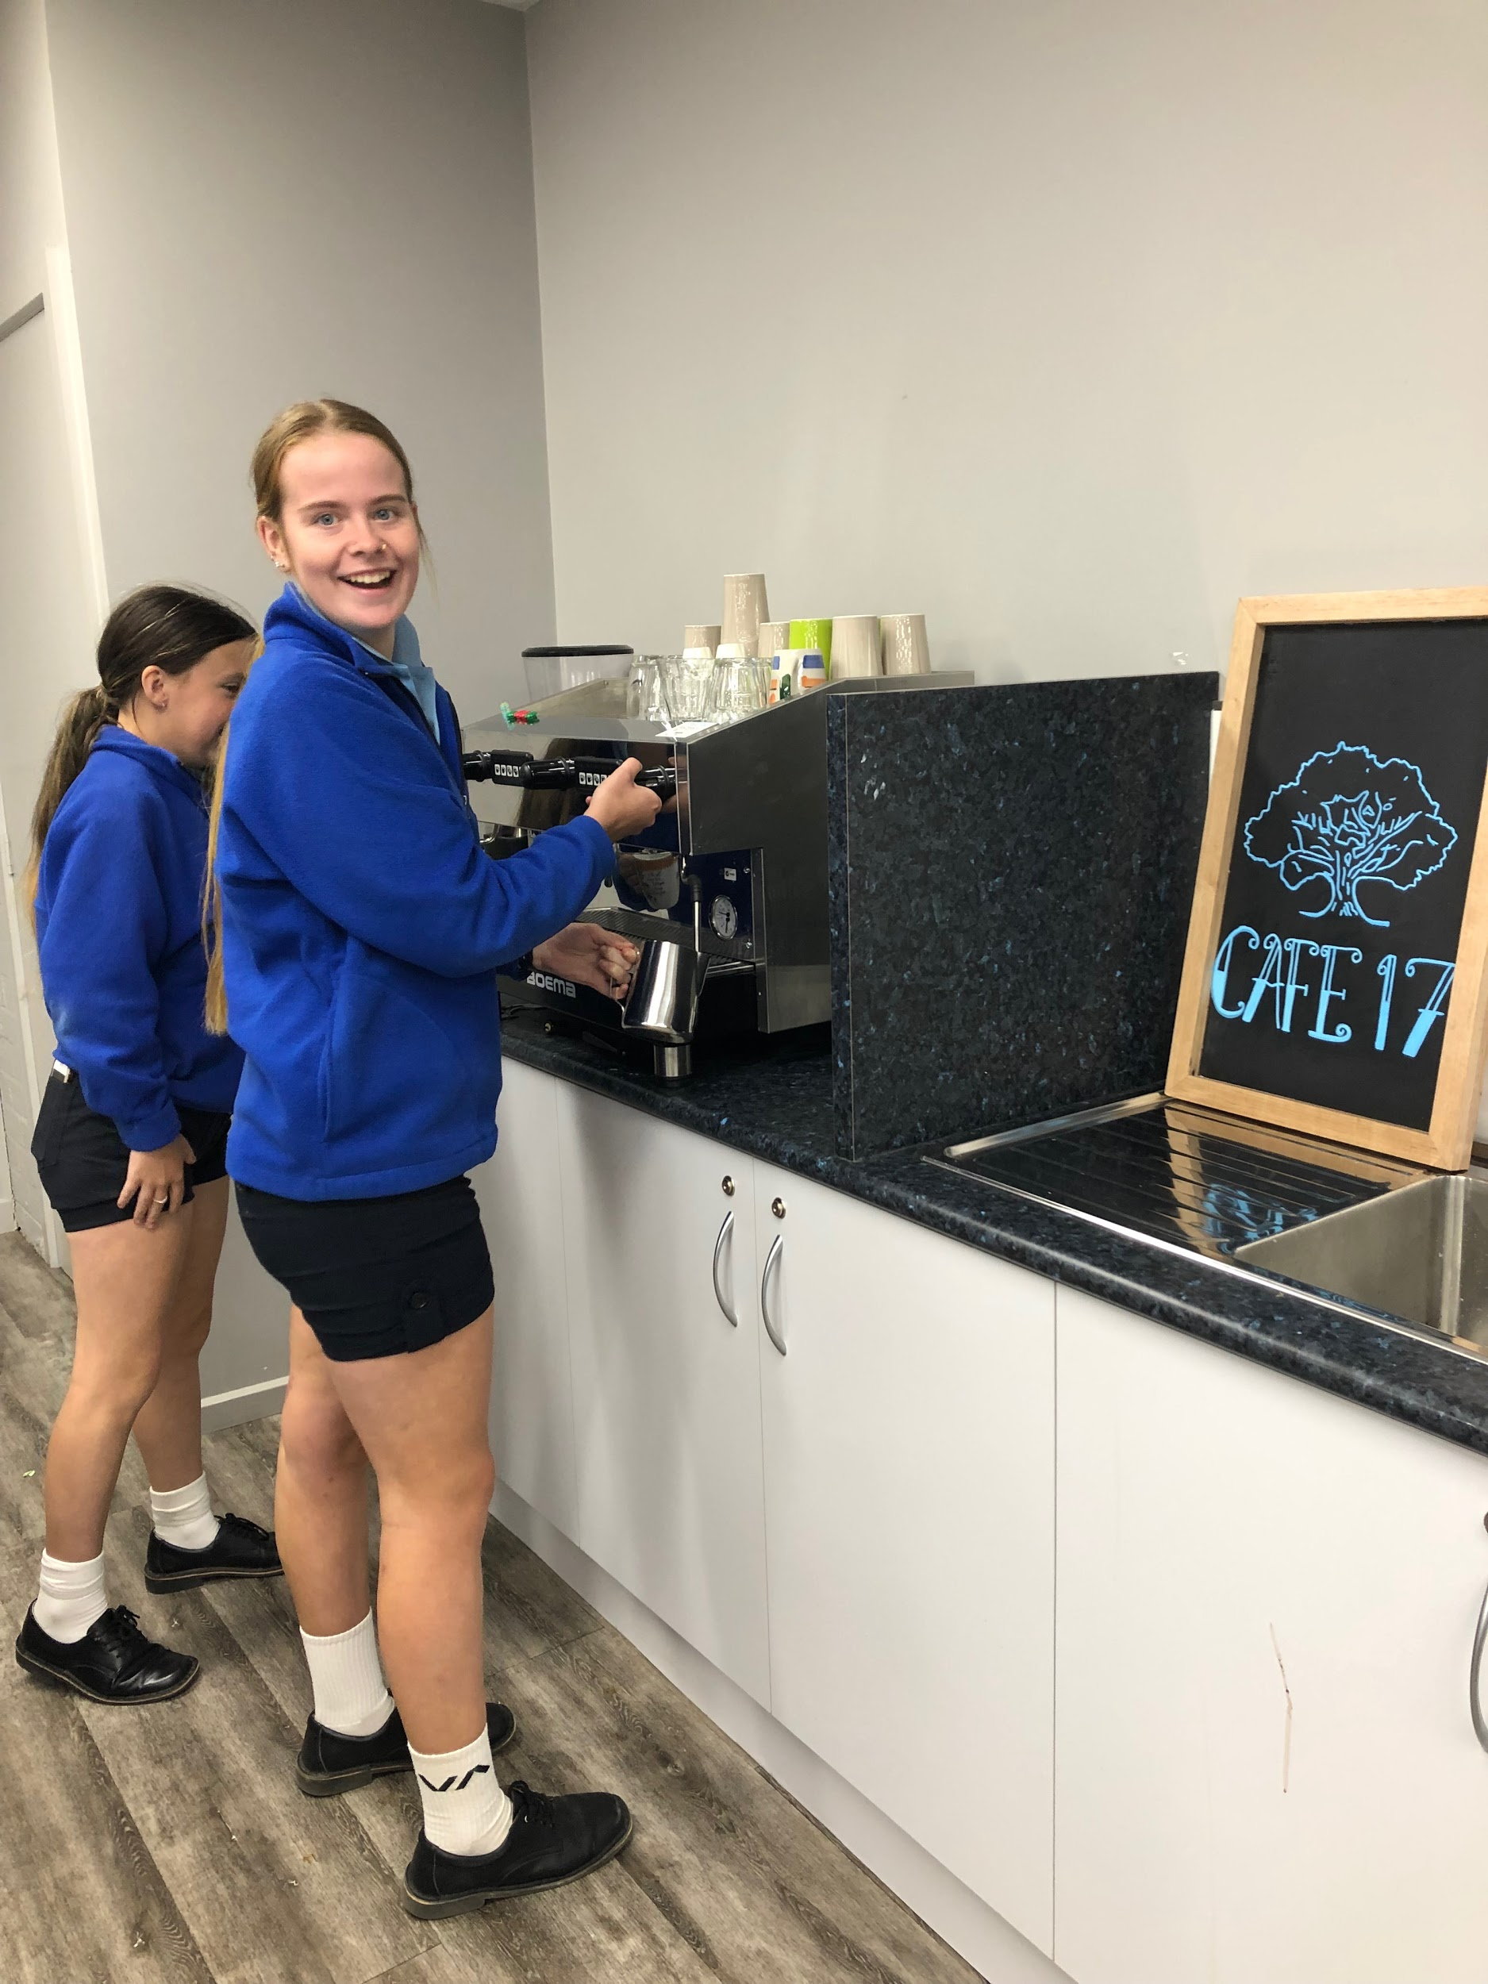
VCAL - Further Information
For any queries, students can drop into my office, parents can call me, ask for Mrs Smith(Head of Applied Learning) or please email me at:-
whited@mcararat.catholic.edu.au

